Slide 1
P2P Money Lending using Blockchain

Slide 2




P2P Money Lending using Blockchain
Purpose of the Project
Remove Middle Men
Clear and Transparent
Reduce Cost
Interactive Portal for Everyone

Slide 3
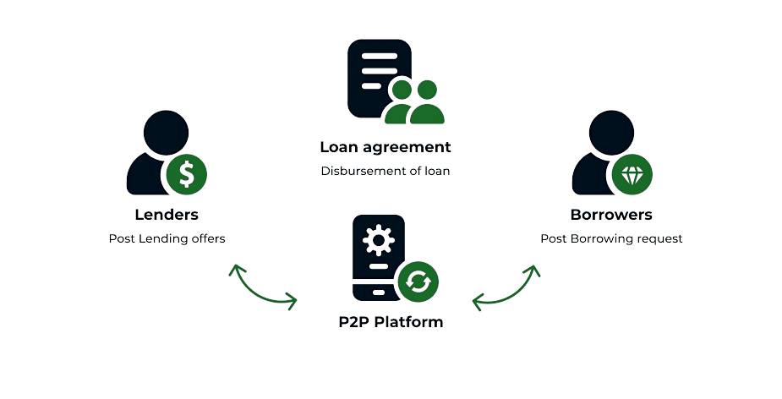
P2P Money Lending using Blockchain
What is Traditional P2P Money Lending?
Tradiitional way of money exhange
Borrower goes to the bank to ask for money
Sign the documents and get money.

Slide 4
P2P Money Lending using Blockchain
Problems with Traditional Model
01
02
03
04
05
Expensive
Hidden Cost
High Chance of Fraud
Limited Follow Up Mechanism
Single Point of Failure

Slide 5
Solution?

Slide 6
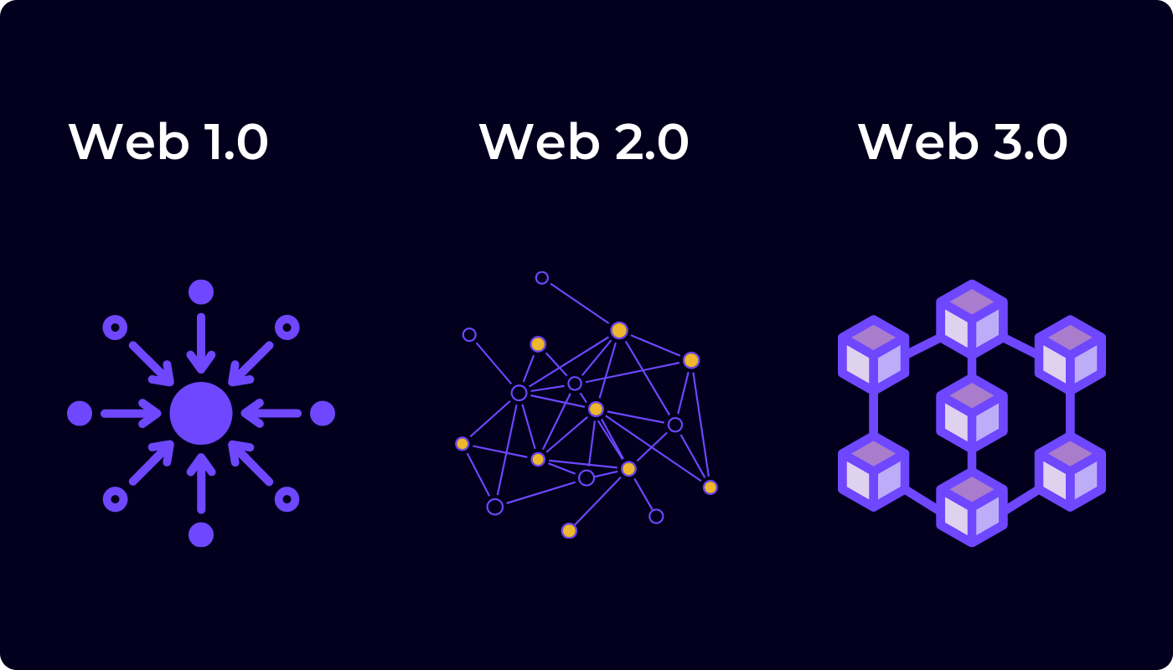
Use Web3 and Blockchain!
So! What is Web3?

Slide 7
How do we leverage Blockchain and Web3?
A decentralized, smart contract-based platform for p2p-lending on the Ethereum Blockchain can play the role of a bank in the process of lending money to one or more beneficiaries.
The open ecosystem of the p2p-lending platform has the potential to offer cheaper lending contracts than traditional centralized institutions, while also enabling people all over the world to profit from a fair and transparent portfolio of products.

Slide 8
How do we use web3?
Ethereum Blockchain Network
Web3 Wallets
Smart Contracts
Meta mask
Debit
Credit
We use meta mask for user management and for transactions

Slide 9
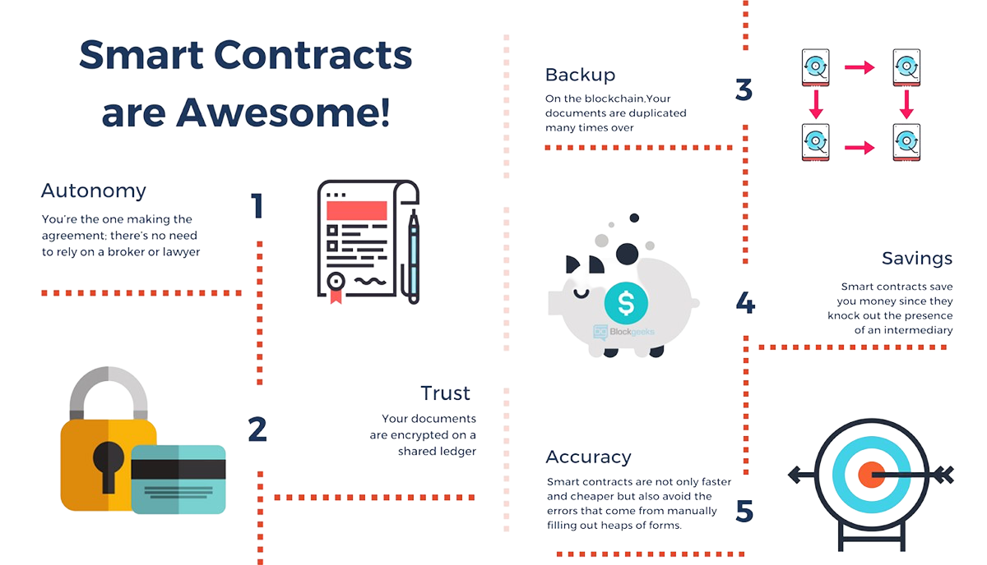
We leverage Smart Contracts for Transactions
What are Smart Contracts?

Slide 10
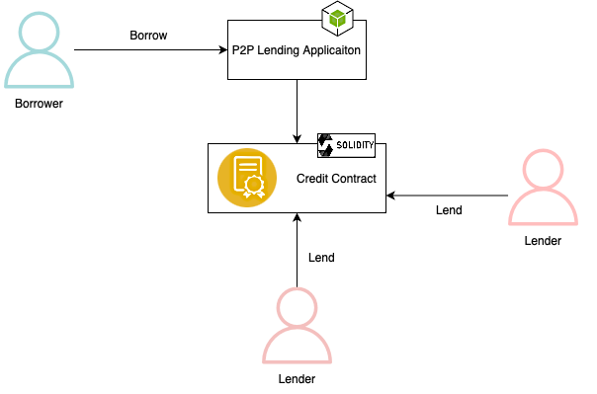
What does are application do?

Slide 11




Tools and Technology Used
Metamask
Node JS
01
02
03
04
A Crypto Wallet
Backend programming language
Truffle
Ganache
Used to build and deploy smart contracts
Local Ethereum test net
A
B
C
D

Slide 12
What does our project do?
Features!!
Ask for funding (borrow)
Provide details of the requested funding.
Withdrawal of funding after successfully reached goal of full funding.
Repayment installments functionality.
Invest in project/credit (lend)
Vote for revoke contract / refund investments.
Mark project as Fraud.

Slide 13
Demo Time!

Slide 14

Real World Application
Can be enhanced and used for the following purposes
Startup Idea Pitches and Investments
Loan Purposes

Slide 15
Future Scope and Enhancement
02
04
01
03
Implement Trust Tokens
Minimize Gas Cost
Create more investor protection
Protection against phishing

Slide 16

Thank You!
Presented By:
Ashish Simon Harrison
Parth Manaktala
Nikita Katari
Aman Bajpayee
Leandro de Almeida

